Slide 1
IBM HACK CHALLENGE 2020 Code for a brighter tomorrow
Problem Statement : Optimized Warehouse Management of Perishable Goods for a Food Delivery Company.
Team Name : The Czar

Slide 2
Team Members:
 | Name | Role
1. | Samrat Chaudhuri | 1) Collection of datasets & development of Machine Learning Model. 2) Development of live Interactive Dashboard. 3) Chatbot development. 4) Deployment and testing of the entire Web App setup. 5) UI development and flow setup using NODE RED.

Slide 3
Technology Stack:
Programming Languages: HTML, CSS, Python, NODE JS.
Database : NoSQL DB such as Cloudant DB.
Hosting Servers : IBM Cloud, Google server.
Server type : REST.
Machine Learning Model Used : Random Forest Regressor Model, NLP, Fuzzy Logic.
Chatbot Features : General queries, stock updation and validation, mental health query, smart document understanding capability.

Slide 4
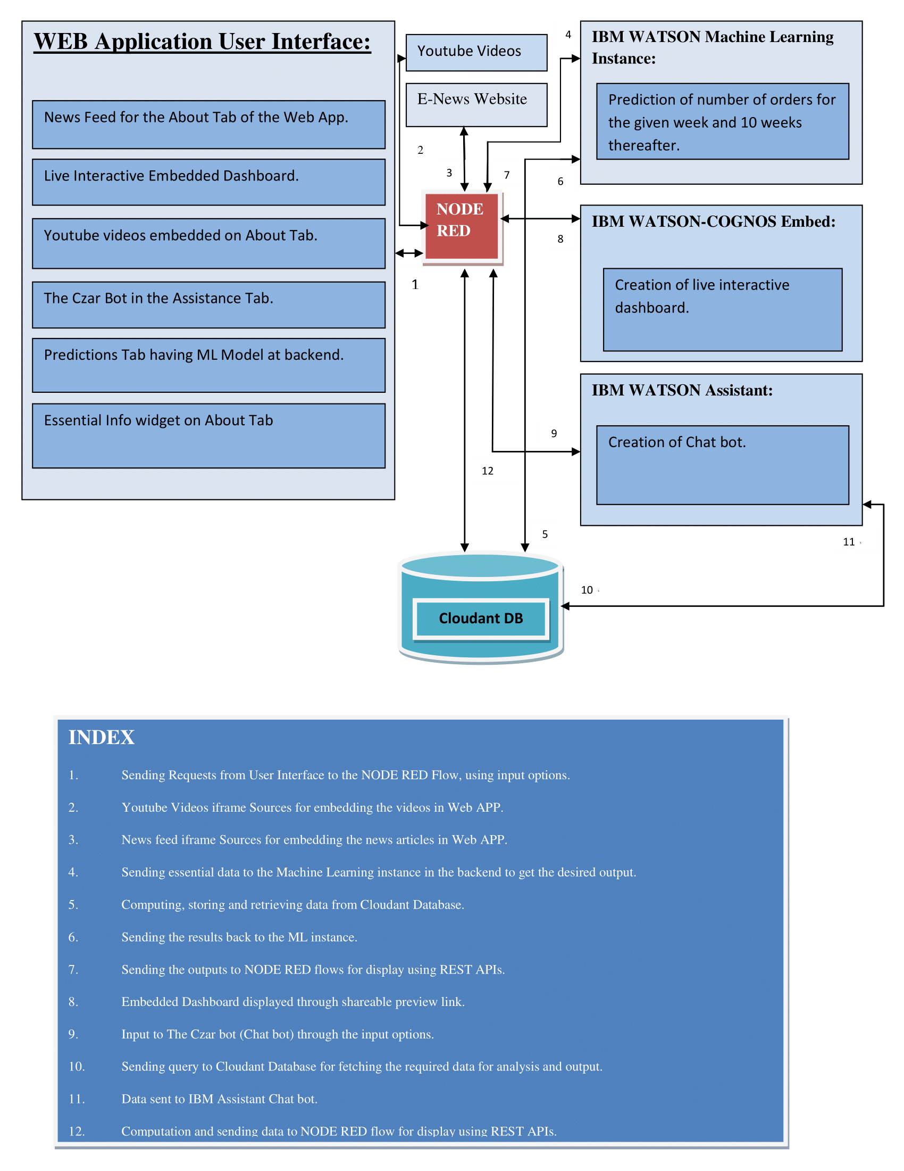
Architecture:

Slide 5
Process Flow:
The user lands on the ABOUT Tab and gets an idea about the working and motive behind the Web App. The User also gets additional information regarding the more complex inputs required for the number of order predictions through the essential info widget, apart from the news and youtube widgets.
In the ASSISTANCE Tab, The Czar bot (Chatbot) is present to guide the user through any queries that he/she might have, while also keeping a tab on the mental health of the user by reciprocating to both positive and negative feedbacks.
The PREDICTIONS Tab contains the main part of our Web Application, that is, the ML Random Forest Regressor model running in the backend to give our user an accurate count of number of orders for 10 weeks in advance.
The DASHBOARD Tab provides the user with an intricate understanding about the target and non target variable dependencies.

Slide 6
Unique Added Value :
The ABOUT Tab gives a unique point of view to the user from the perspective of the philanthropic entrepreneur.
The news widget and the video widget keeps the user entertained as well as well informed about the surroundings.
The Czar bot is of immense assistance to the user. It not only provides the answers to the general queries of the user, such as questions regarding the warehouse stocks, etc and basic greetings, but also keeps a preliminary check on the mental health of the user, through reciprocation and interaction to both positive and negative feedbacks.
The Czar bot also has a smart document understanding system, which enables it to interpret more complex queries such as information about recent competitors and governmental policies regarding the food delivery business and likewise.
The Dashboard provides a unique and detailed analysis of the various dependencies as per the variation of every attribute of the dataset.

Slide 7
IBM Services:
NODE RED, visual flow editor.
IBM Assistant.
IBM COGNOS Embed.
IBM Machine Learning Instance.
IBM Watson Studio.
IBM Discovery Service.
IBM Function service.

Slide 8
User Interface:
Google Sheets.
NODE RED Template nodes along with appropriate HTML and CSS codes.
Youtube iframes.
Independent UK newspaper iframe.
Google photos.

Slide 9
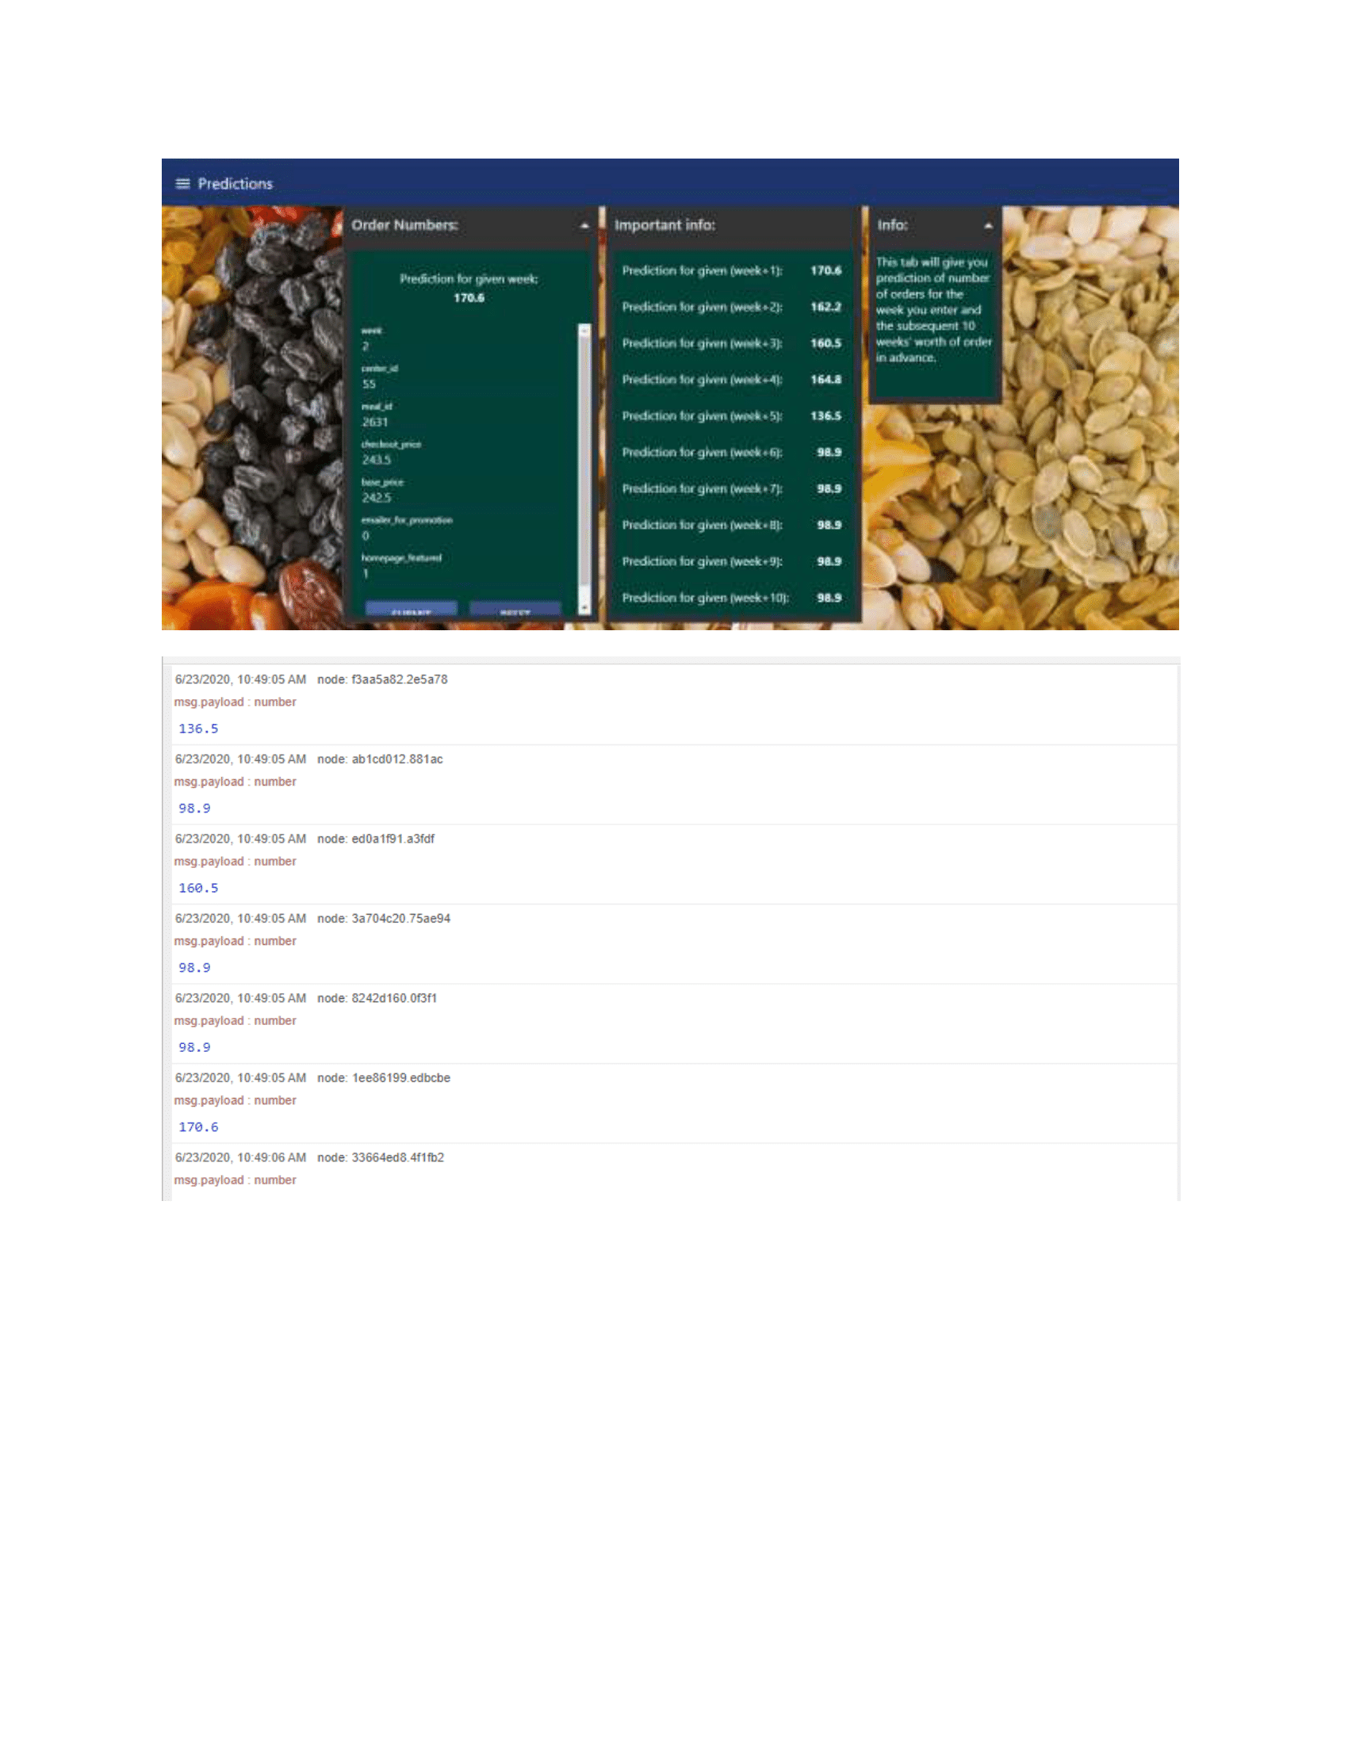
Working:

Slide 10
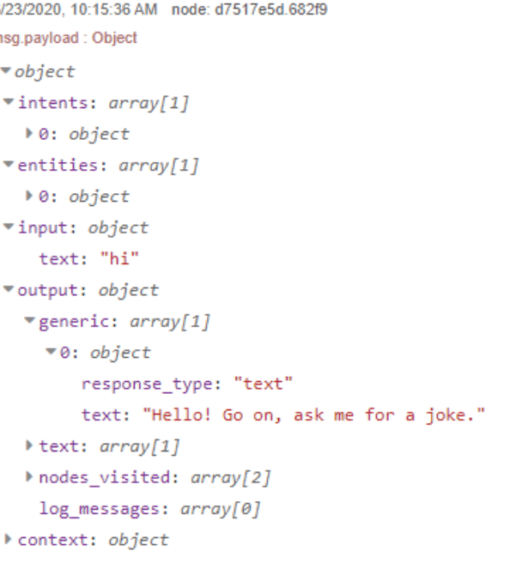
Working:

Slide 11
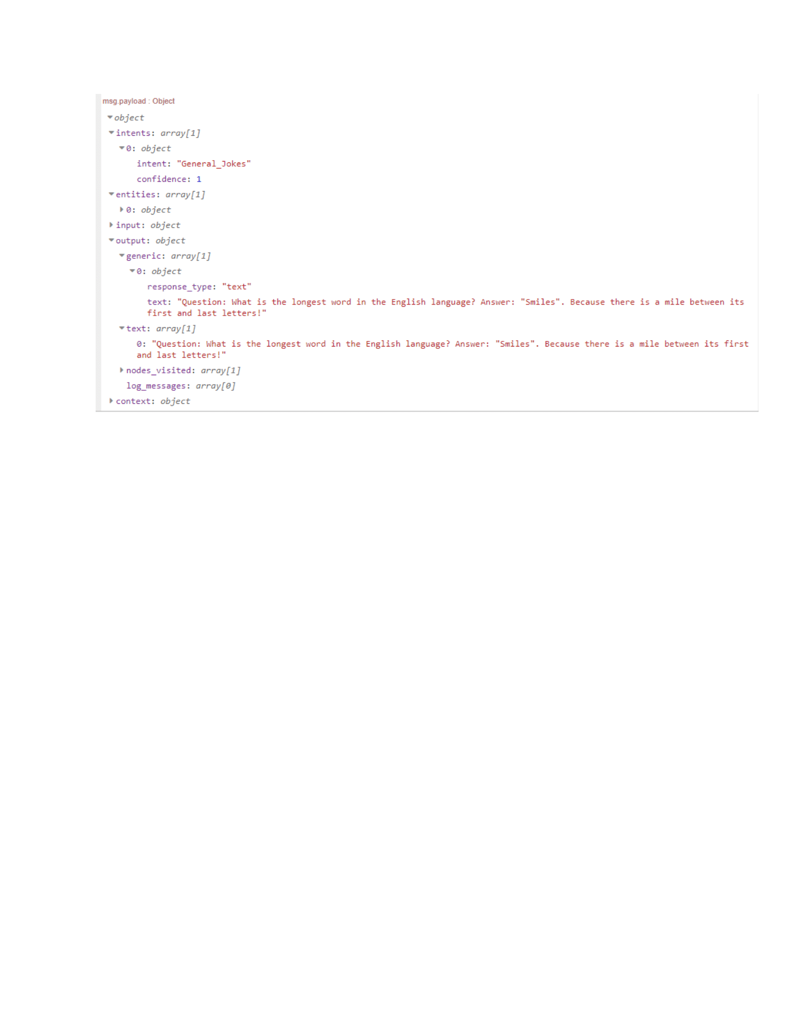
Working:

Slide 12
Thank You!!

